Slide 1
GRAPH

Slide 2
Outline
1.Graph and Graph Models
2.Graph Terminology and Special Types of Graphs
3.Representing Graphs and Graph Isomorphism
4.Connectivity
5 .Euler and Hamiltonian Paths
6. Shortest-Path Problems
7. Planar Graphs
8. Graph Coloring

Slide 3
Introduction to Graphs
A graph G = (V, E) consists of V, a nonempty set of vertices (or nodes), and E, a set of edges. Each edge has either one or two vertices associated with it, called its endpoints. An edge is said to connect its endpoints.
eg.
G=(V, E), where
V={v₁,v₂,…, v₇}
E={{v₁,v₂}, {v₁,v₃}, {v₂,v₃}
{v₃,v₄}, {v₄,v₅}, {v₄,v₆}
{v₄,v₇}, {v₅,v₆}, {v₆,v₇}}
v₁
v₅
v₃
v₄
v₆
v₂
v₇

Slide 4

Simple graph:
A simple graph is a graph with no loops and no multiple edges.
So we can say that a simple graph has-no arrays and no loops.
Multi graph:
If a graph contains no loops but parallel edges is called multi graph.
that is multi graph allows for multiple edges between pair of vertices but
does not allow for loops.
V₁
V₅
V₃
V₄
V₆
V₂
V₇

Slide 5
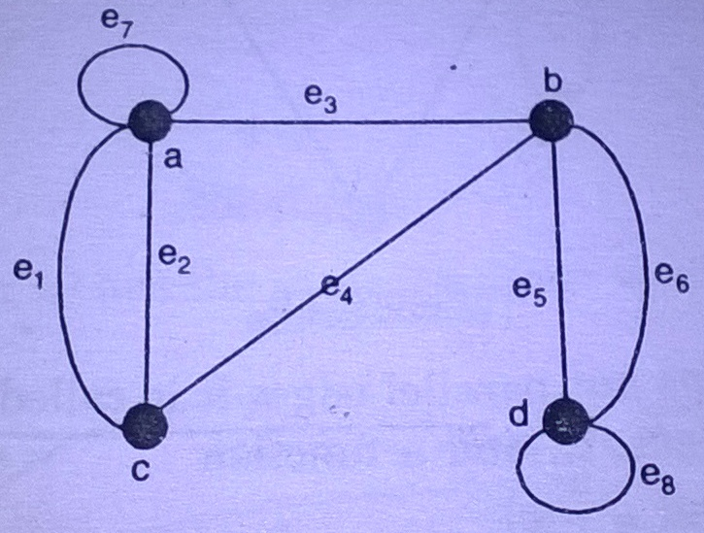
Pseudo graph:
If both loops and parallel edges are allow then it is called pseudo graph.

Slide 6
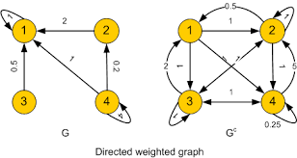
Directed Graph
When the edges in a graph have a direction, the graph is called directed (or digraph)

Slide 7
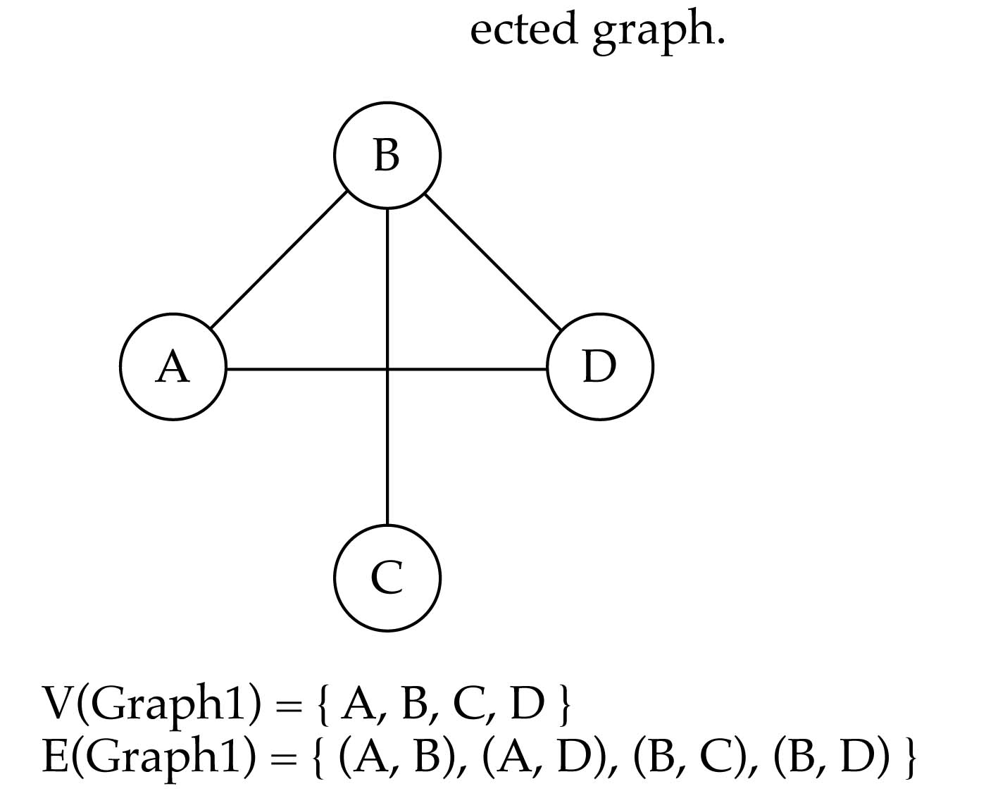
Undirected Graph
When the edges in a graph have no direction, the graph is called undirected

Slide 8
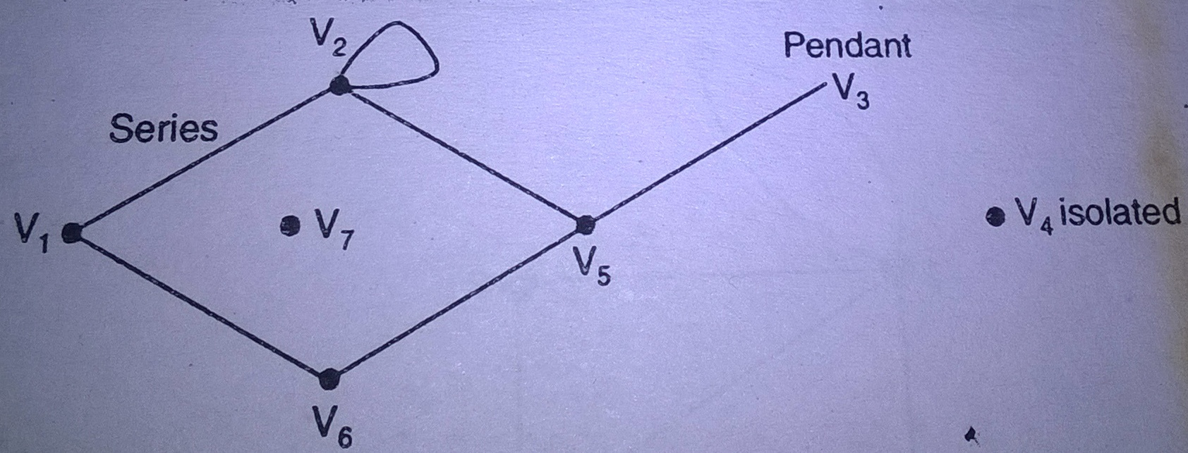
Isolated and pendant vertex
A vertex having no incident edges in the graph is called an isolated vertex.the degree of an isolated vertex is zero.
A vertex of degree one is known as pendant vertex.

Slide 9
Graph Terminology
Def 1. Two vertices u and v in a undirected graph G are called adjacent (or neighbors) in G if {u, v} is an edge of G.
Degree
Def 2. The degree of a vertex v, denoted by deg(v), in an undirected graph is the number of edges incident with it.
Note : adjacent: a vertex connected to a vertex
incident: a vertex connected to an edge

Slide 10
The degrees of the vertices in the graph
b
deg(a)=4
a
c
Sol :
deg(b)=5
deg(c)=1
deg(d)=5
e
d
f
deg(e)=6
H
deg(f)=0

Slide 11
In-degree and Out-degree
G = (V, E) : directed graph,
deg⁻(v) : edges with v as a terminal.
(in-degree)
deg⁺(v) : edges with v as a initial vertex (out-degree)
Example .
deg⁻(a)=2, deg⁺(a)=4
deg⁻(b)=2, deg⁺(b)=1
deg⁻(c)=3, deg⁺(c)=2
deg⁻(d)=2, deg⁺(d)=2
deg⁻(e)=3, deg⁺(e)=3
deg⁻(f )=0, deg⁺(f )=0
b
a
c
e
d
f

Slide 12
Regular Graph
A simple graph G=(V, E) is called regular if every vertex of this graph has the same degree. A regular graph is called n-regular if deg(v)=n
eg.
K₄ :
is 3-regular.

Slide 13
Some Special Simple Graphs
Complete graph
The complete graph on n vertices, denoted
by K_{n}, is the simple graph that contains
exactly one edge between each pair of
distinct vertices.
K₂
K₃
K₄

Slide 14
Bipartite graph
A simple graph G=(V,E) is called bipartite if V can be partitioned into V₁ and V₂, such that every edge in the graph connect a vertex in V₁ and a vertex in V₂.
Example
v₁
v₂
v₃
v₄
∴ C₆ is bipartite.
v₅
v₆
V₁
V₂

Slide 15
Example- the graph G is bipartite
a
b
a
c
g
c
e
b
f
f
d
d
g
e
G
Yes

Slide 16
Example- Complete Bipartite graphs (K_{m,n})
K_{2,3}
K_{3,3}

Slide 17
New Graphs from Old
A subgraph of a graph G=(V, E) is a
graph H=(W, F) where W ⊆ V and F ⊆ E.
(Notice the f point w to connect)
Example- A subgraph of K₅
a
a
e
b
b
e
d
c
c
K₅
subgraph of K₅

Slide 18
※Isomorphism of Graphs
u₁
u₂
v₁
v₂
G1 is isomorphic to G2
u₃
u₄
v₃
v₄
G1
G2
Def:
The simple graphs G₁=(V₁,E₁) and G₂=(V₂,E₂) are isomorphic if they have a identical behavior in terms of geometric property.
Isomorphism graphs there will be:
(1) The same number of points (2) The same number of edges
(3) The same number of degree

Slide 19
Planar Graphs
A graph is called planar if it can be drawn in the plane without any edge crossing. Such a drawing is called a planar representation of the graph.
Example:
∴ K₄ is planar
K₄
K₄ drawn with no crossings

Slide 20
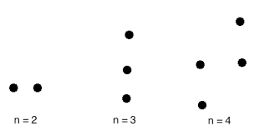
Null graph
A graph with n vertices and zero edges is called a null graph.
A null graph is totally disconnected graph and denoted by Nn.
Every vertex of null graph is an isolated vertex.
A graph of order n is a null graph if and if it is a regular of regularity zero.

Slide 21
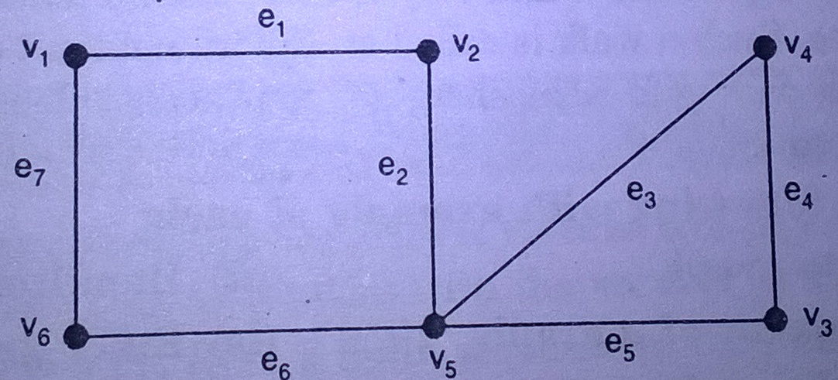
Euler graph A closed walk in a graph G containing all the edges of G is called an Euler line in G. A graph containing an Euler line is called an Euler graph.

Slide 22
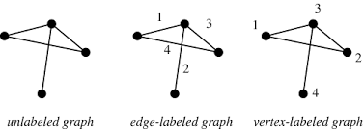
Labelled graph
A graph G=(V,E) is known as labelled graph if its edges are labelled with name or data.we write lables in place of an ordered pair in the edge set.
G=[{1,2,3,4,5},{e1,e2,e3,e4,e5}]

Slide 23
Operation of graph
1.union
2.intersection
3.sum of two graphs
4.ring sum
5.products of graph
6.composition
7.fusion
8.complement

Slide 24
The union of two simple graphs
G₁=(V₁, E₁) and G₂=(V₂, E₂) is the simple graph
G₁∪G₂=(V₁∪V₂, E₁∪E₂)
Example:
a
b
c
a
b
c
G₁
G₂
d
e
d
f
a
b
c
G₁∪G₂
d
e
f

Slide 25

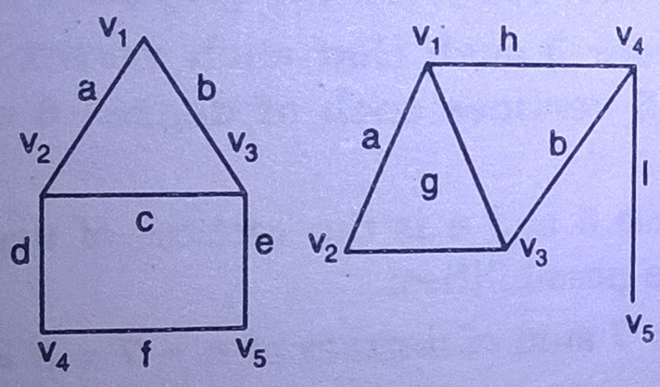
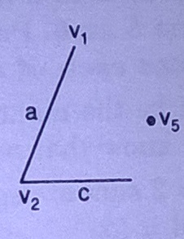
Intersection the intersection is a graph G4 consisting only of those vertices and edges that are in both G1 and G2. G=

Slide 26


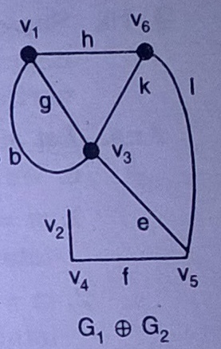
Ring sum the two graph G1 and G2 is a graph consisting of vertex set and of edge that are either in G1 or G2 but not in both.

Slide 27
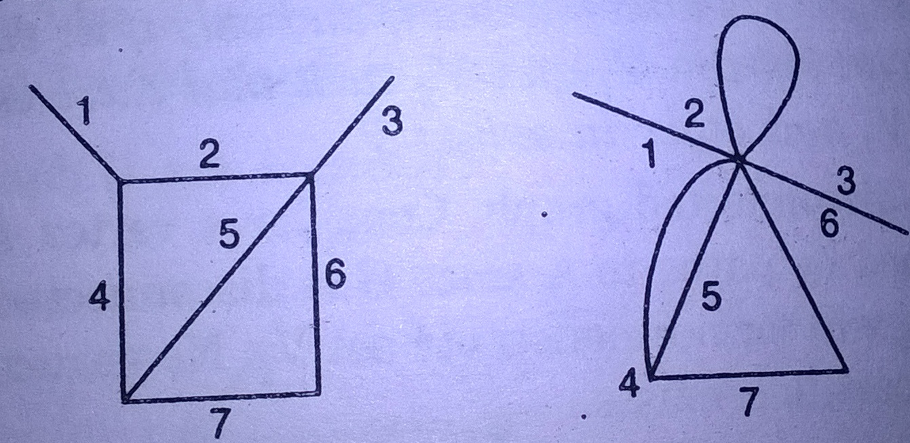
Fusion A pair of vertices a,b in a graph are said to be fused (merged or identified) if two vertices are replaced by a new vertex such that every edge that was incident or either a or b or on both is incident on new vertex.

Slide 28
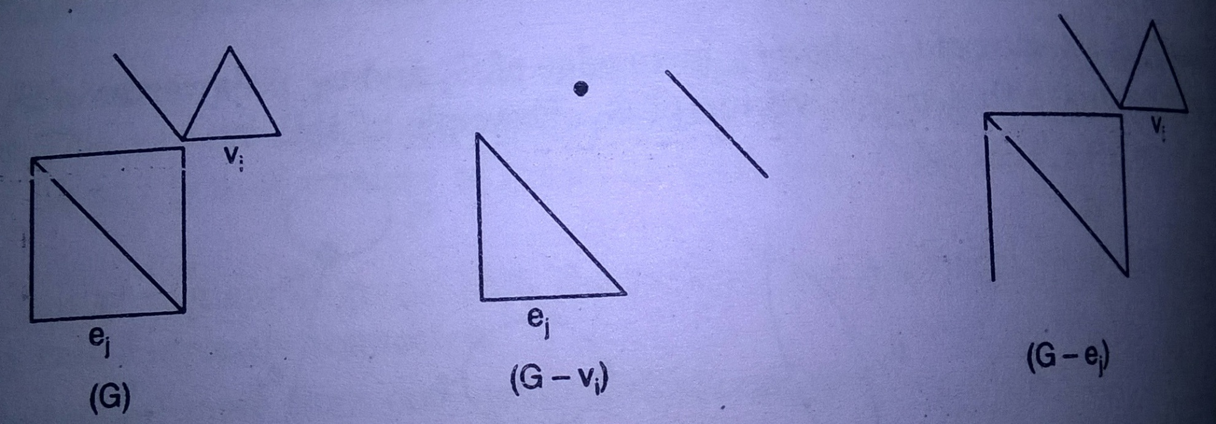
Deletion in this graph there are if we delete the any vertex so all the edges is deleted to relate them. and if we delete the any edges so it is not affect the any vertex only those edges will be deleted.

Slide 29
Graph Coloring
A coloring of a simple graph is the assignment of a color to each vertex of the graph so that no two adjacent vertices are assigned the same color.
Example:
2
1
2
3
5
1
1
2
1
1
4
3
3
2
5-coloring
3-coloring
Less the number of colors, the better

Slide 30
Matrix in the graph
Graph can be represented in the form of the matrix
Different matrix that can be formed are:
1.adjacency matrix
2.incidence matrix
3.cut set matrix
4.circuit matrix
5.path matrix

Slide 31
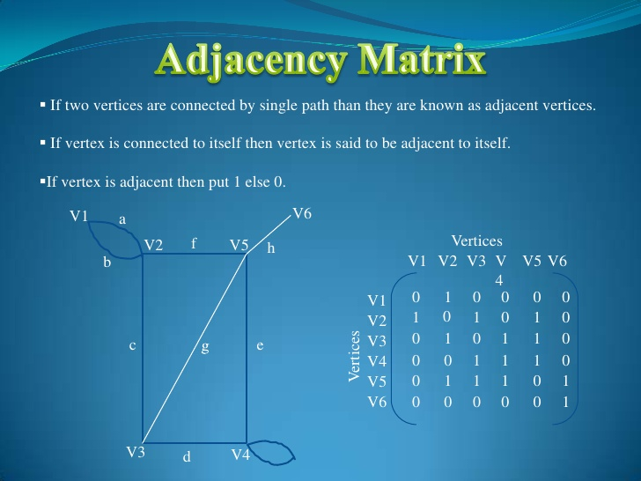

Slide 32
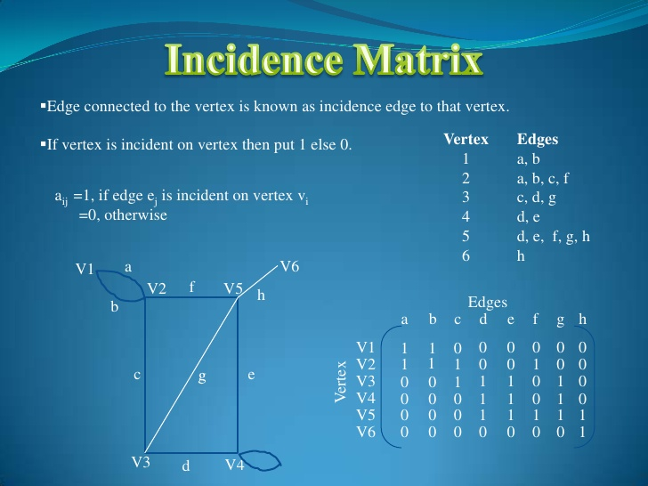

Slide 33
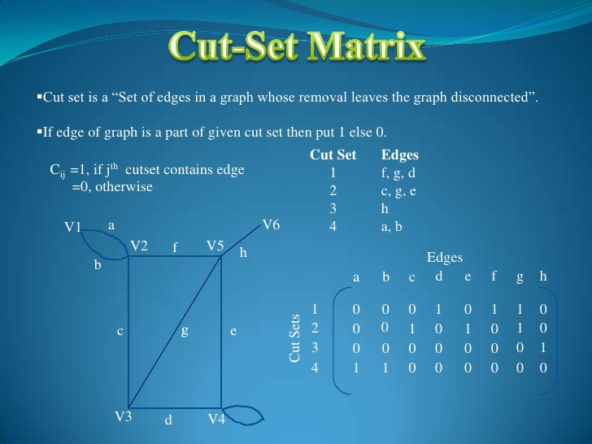

Slide 34
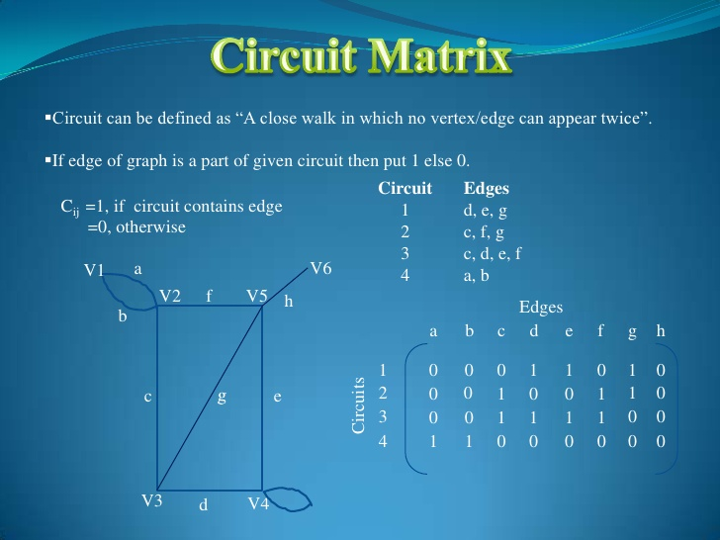

Slide 35
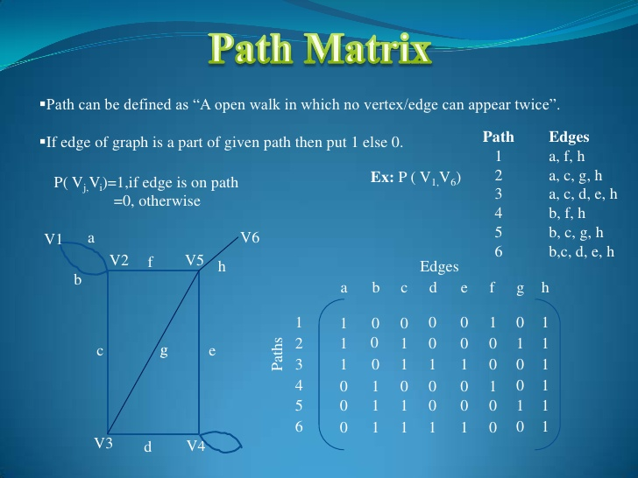

Slide 36
Shortest-Path Problems
Def:
1. Graphs that have a number assigned to each edge are called weighted graphs. 2. The length of a path in a weighted graph is the sum of the weights of the edges of this path.
Shortest path Problem:
Determining the path of least sum of the weights between two vertices in a weighted graph.

Slide 37
Example 1. What is the length of a shortest path between a and z in the weighted graph G?
b
3
c
Sol.
L=0
a
(1)
(2)
2
a
L=2
4
2
z
L=4
d
a
3
b
1
b
2
(3)
4
G
(4)
4
d
3
e
a
a
2
L=5
2
d
3
d
e
b
(5)
4
L=6
a
z
length=6
2
1
d
3
e

Slide 38
Example 2. Use Dijkstra’s algorithm to find the length of a shortest path between a and z in the weighted graph.
4(a)
∞
∞
∞
b
5
d
Sol.
b
5
d
b
5
d
4
6
4
6
4
6
8
0
8
⇒
0
8
a
1
z
a
1
z
a
1
z
2
2
∞
2
∞
2
3
2
3
2
3
c
10
e
c
10
e
c
10
e
∞
∞
∞
2(a)
3(c)
3(c)
3(c)
8(b)
10(c)
8(b)
b
5
d
b
5
d
b
5
d
⇒
⇒
6
⇒
4
6
4
6
4
0
8
0
8
0
8
14 (d)
a
z
a
z
a
1
z
1
2
1
2
2
∞
∞
2
3
2
3
2
3
e
e
c
10
e
c
10
c
10
2(a)
12(c)
2(a)
12(c)
2(a)
10(d)

Slide 39
Contd
3(c)
8(b)
3(c)
8(b)
b
5
d
b
5
d
4
6
4
6
0
8
14(d)
⇒
0
8
13(e)
a
1
z
a
1
z
2
2
2
3
2
3
c
10
e
c
10
e
2(a)
10(d)
2(a)
10(d)
3(c)
8(b)
b
5
d
⇒
4
6
⇒ path: a, c, b, d, e, z length: 13
0
8
13(e)
a
1
z
2
2
3
c
10
e
2(a)
10(d)

Slide 40
The Traveling Salesman Problem:
A traveling salesman wants to visit each of n cities exactly once and return to his starting point. In which order should he visit these cities to travel the minimum total distance?
Example (starting point D)
S
113
D→T→K→G→S →D: 458
G
137
147
142
98
167
D→T→S→G→K→D: 504
56
D
135
D→T→S→K→G→D: 540
58
K
133
T
…

Slide 41
Thank you

